Slide 1

Project 1 CO concentration Level prediction
8조 진형남, 박민수, 신명진, 장대근

Slide 2
목차
Problem Statement
Exploration
Domain Exploration (Literature Review)
Data Exploration
Methods & Results
Overall Approach
Summary: Models & Results
Conclusion

Slide 3
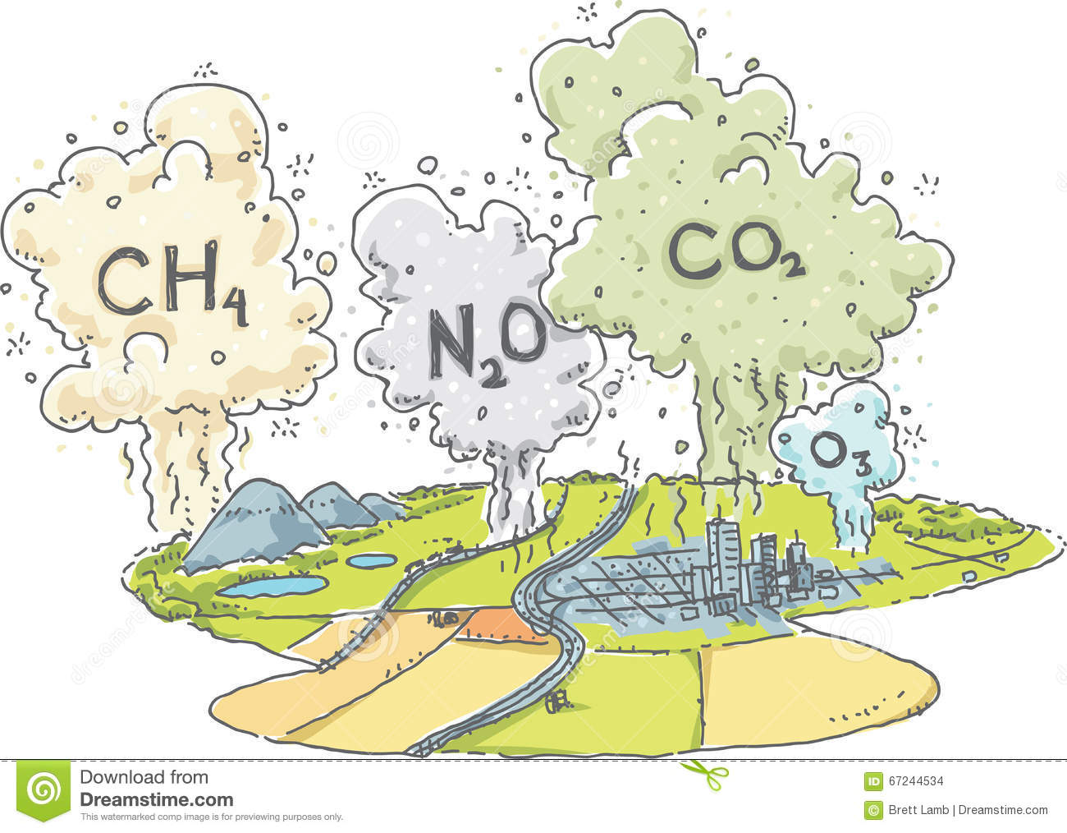



Problem Statement
Predict CO concentration levels from 16 gas sensor data
Given data

Slide 4
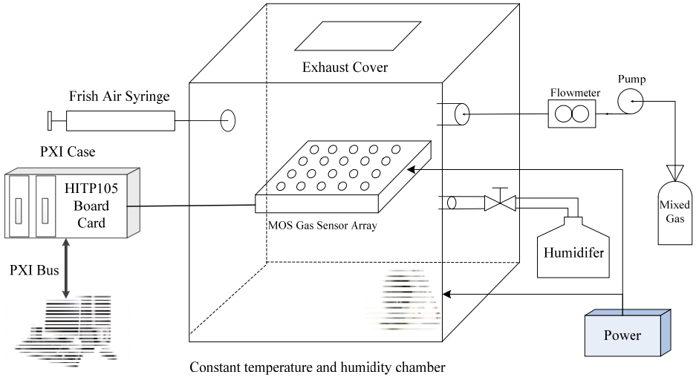
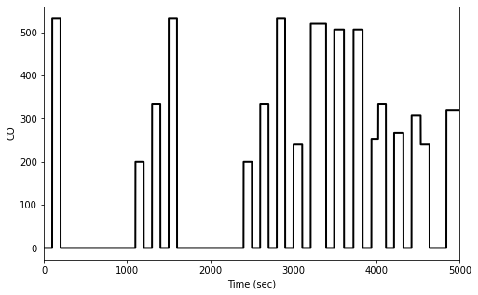
Domain Exploration (1/2) by Literature Review
(General) In-Lab Mixed Gas Test Environment
① Mixed air injection
Delayed sensor response due to:
Remaining gas in the chamber (before fully exhausted)
Sensor array structure
Sensor internal characteristics (∵ analog lowpass filter)
☞ 1) Need to align measured signals with reference CO
2) Need additional attributes reflecting abrupt changes
② Fresh air injection
① Mixed air injection ② Fresh air injection
Reference
Measured
*Ref.: Yonghui Xu, et al., “Research on a Mixed Gas Recognition and Concentration Detection Algorithm Based on a Metal Oxide Semiconductor Olfactory System
Sensor Array,” Sensors, 2018

Slide 5
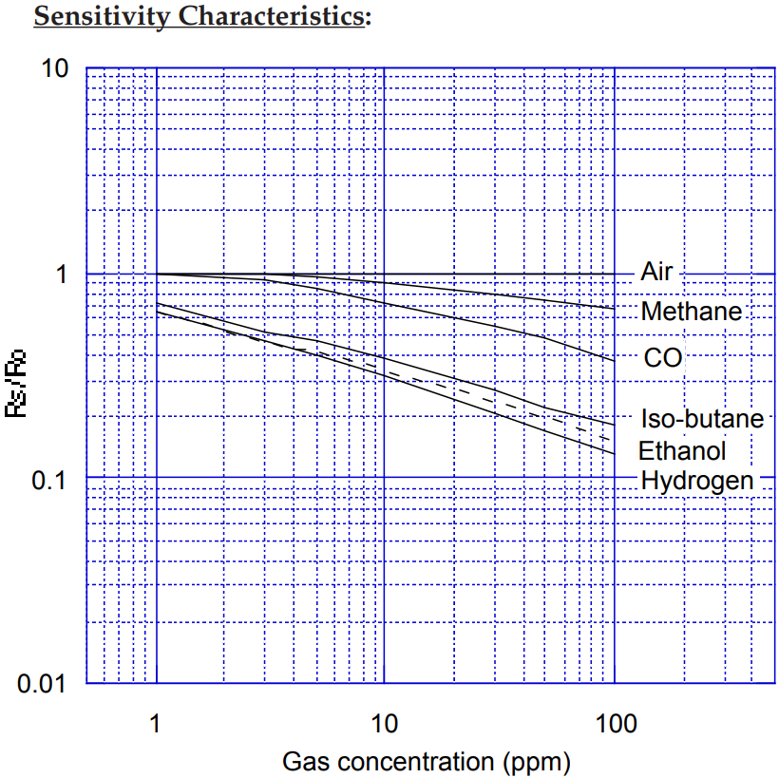
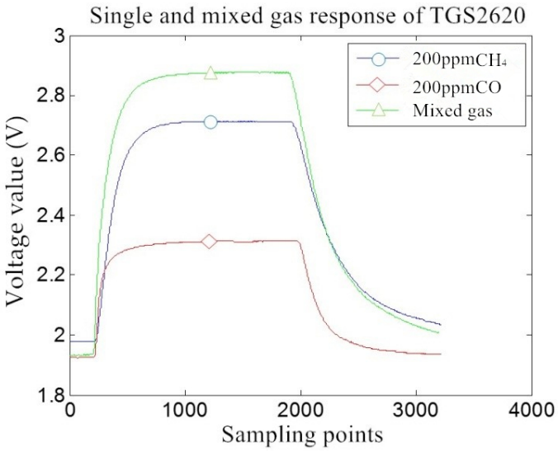
Domain Exploration (2/2) by Literature Review
Nonlinearity in Cross-sensitivity characteristics & Mixed response
☞ Model should represent these nonlinearities!
TGS2600
“The response output of the sensor to the mixed gas is not equal to the sum of the responses of the sensor to the two target gases and has a nonlinear characteristic.”
*Ref.: Datasheets (Sensor specifications) of FIGARO TGS Series Sensors
*Ref.: Yonghui Xu, et al., “Research on a Mixed Gas Recognition and Concentration Detection Algorithm Based on a Metal Oxide Semiconductor Olfactory System Sensor
Array,” Sensors, 2018

Slide 6
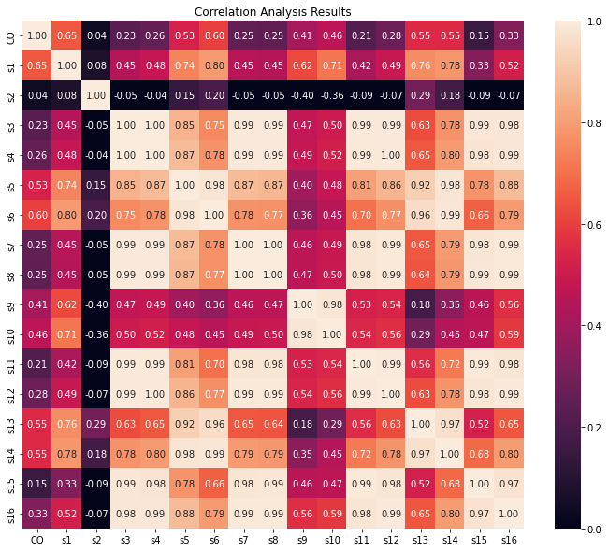
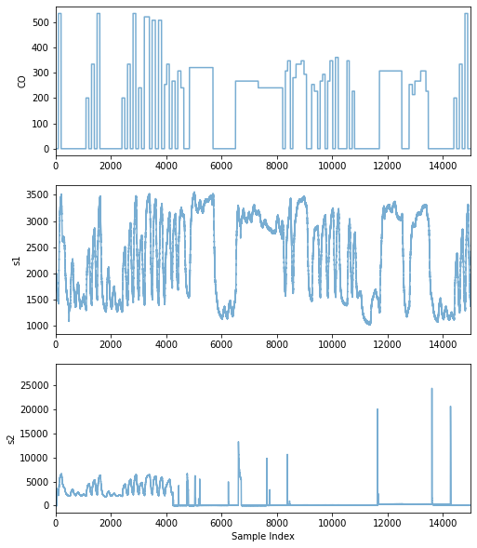
Data Exploration (1/3)
Cross-Correlation Analysis: ① Sensor Failure @ “s2” → Exclusion?
② Similar Sensors → Selection or Merge?
Sensor may be failed at this point!

Slide 7
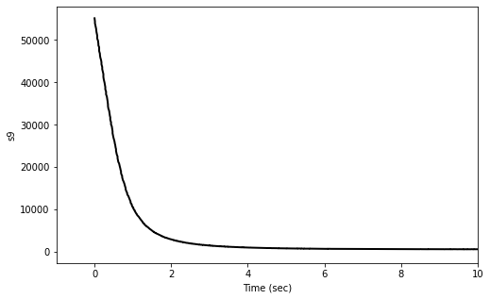
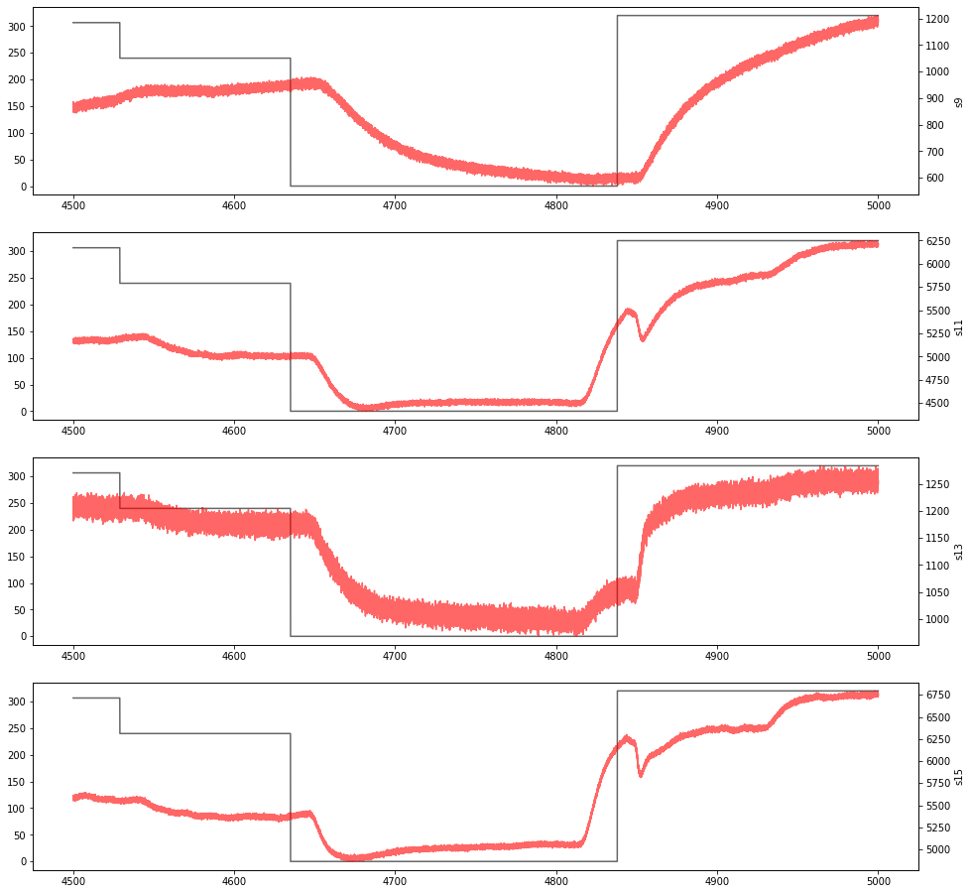
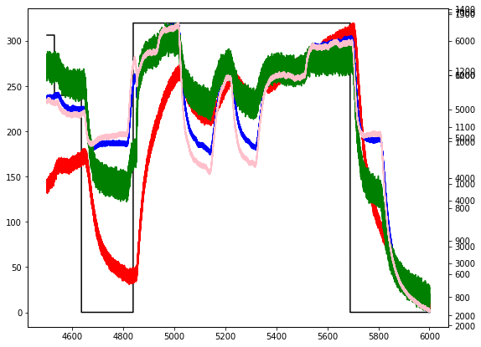
Data Exploration (2/3)
Unstabilized
region exists!
(e.g., “s9”)
Need of Signal Shifts → 2000 samples shifted!
Delayed
sensor
response
Map to 310
Map to 0
*Measured signal = Lowpass-filtered form of target signal
**Poor ability to track abrupt change in CO concentration level
→ Need additional information reflecting abrupt changes

Slide 8
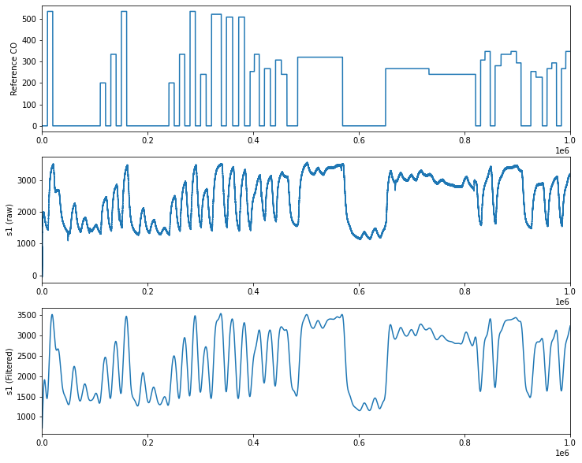
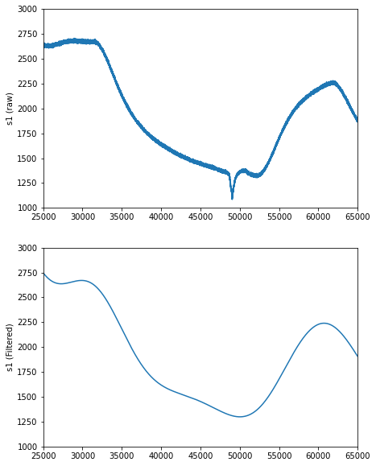
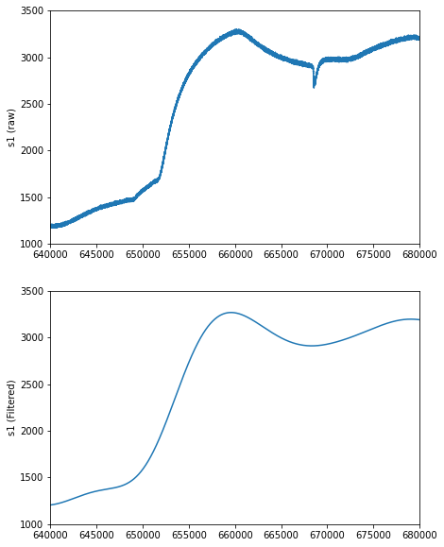
Data Exploration (3/3)
Need of Signal Conditioning → Zero-Phase Lowpass Filter Applied!
Max
①
<Raw>
Impulsive noise exists!
Min
②
②
①
<Filtered>
<Raw>
<Filtered>

Slide 9
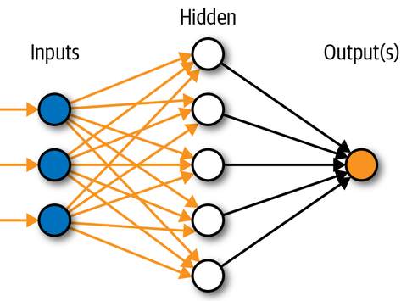
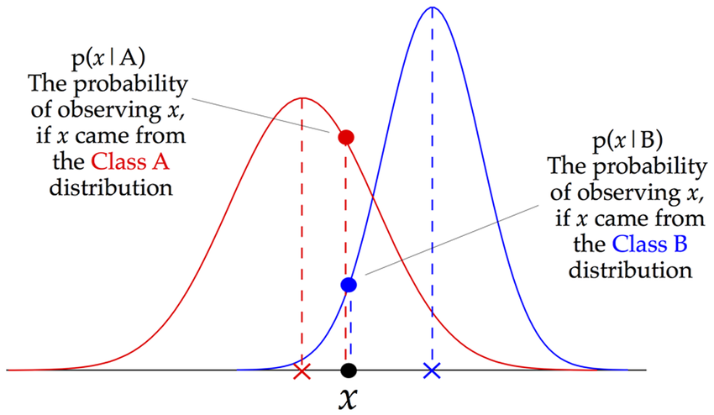
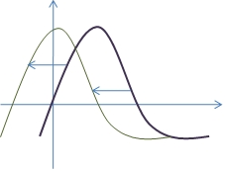
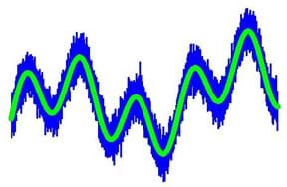
Overall Approach
Best strategy
Preprocessing
Main Processing
Post Processing
Data
Data cleaning
Linear Regression
Nearest Mapping
*Exclude “s2” col.
*Column selection & merge
XGBoost
Pre-
knowledge
Signal conditioning
CNN
Probabilistic Mapping (by Gaussian NB)
*Lowpass filtering
Signal shifting
MLP
*2000 samples shift

Slide 10
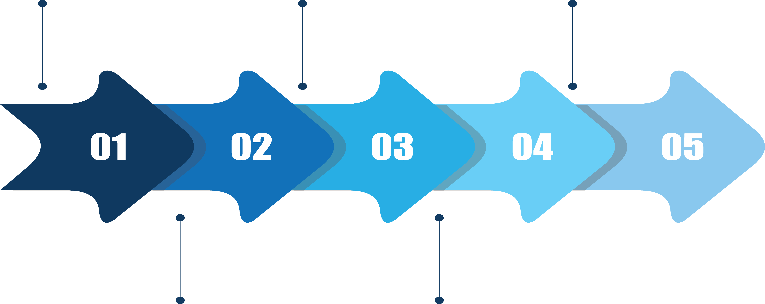
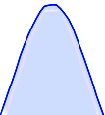
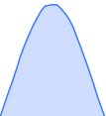
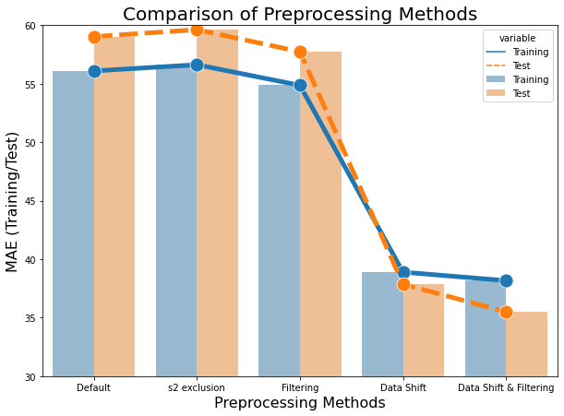
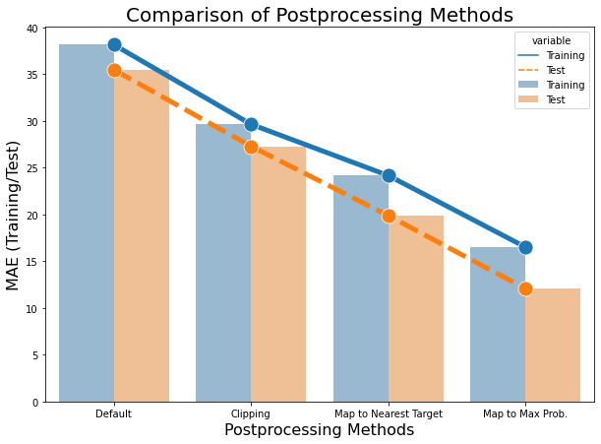
Pre- & Post-processing (79.5 % MAE reduced w/ Linear Regression)
All raw data (Default)
Filtering (fc=1Hz)
Shift&Filtering
533.33
...
0
*Gaussian Naive Bayes (NB) classifier
“s2” exclusion
Data shift (2000 samples)
Min-Max Clipping
Mapping to Nearest CO
Mapping to CO w/ maximum probability
40 %
decreases
(59.0→35.5)
66 %
decreases
(35.5→12.1)
*Performance evaluated with linear regression (LR) model
*Performance evaluated with linear regression (LR) model

Slide 11
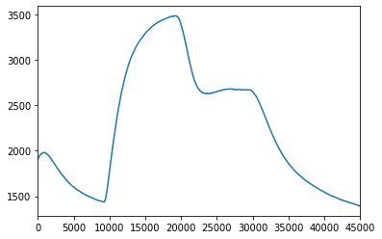
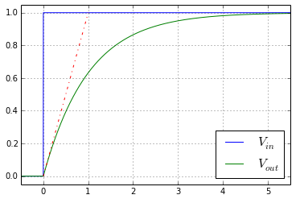
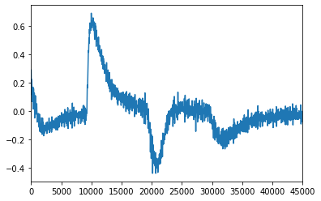
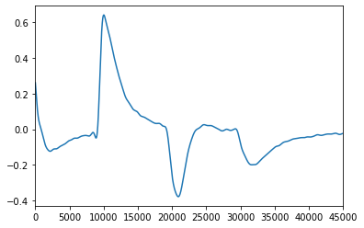
Attribute (Column) Augmentation
Slope (1st derivative) of Each Attribute → Identify abrupt changes
Differentiation
Slope
Filtered
signal (X)
Differentiated X
(dX)
Identify this region (abrupt change point) using the slope information
Filtered dX
Zero-Phase Lowpass Filtering

Slide 12
Summary: (Combined) Models & Results
70.0
Pre- & Post- processing
Raw model
60.0
Raw model
*All combined
Lowpass filtering
Time shifts
Attributes augmentation
Probabilistic mapping
Hyperparameter tuning
50.0
Hyperparameter tuning
Time shifts & Filtering
40.0
Test Score (MAE)
30.0
Nearest mapping
Time shifts & Filtering
20.0
Time shifts & Filtering
Probabilistic mapping
10.0
Probabilisticmapping
Hyperparameter tuning
All combined
0
Linear Regression (Best MAE = 12.1)
XGBoost (Best MAE = 53.5)
CNN (Best MAE = 6.9)
MLP (Best MAE = 6.0)

Slide 13
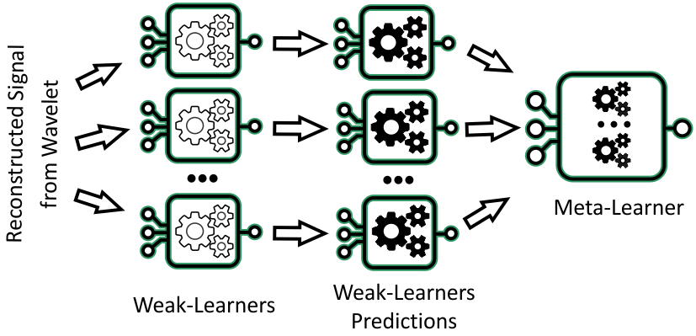
Conclusion
“No Free Lunch”
Further Works
Linear regression
Simple but powerful (∵ highly correlated data)
Limited performance (∵ only linear relationship)
XGBoost
Good for classification (than regression tasks)
Poor at extrapolation (depends on training set)
CNN
Good for data with spatial relationship
MLP - Achieved the best performance
Good for time-series prediction (w/ tabular data)
But too many parameters (∵ full connection)
Different time shifts per sensors (columns)
Use CNN w/ spatial representation (e.g., spectrum)
Use RNN models - e.g., LSTM, Transformer
Ensemble model
 | s1 | s11 | s13 | s15
Optimal Time Shift* | 4700 | 2700 | 2300 | 2200
*Calculated by the maximum cross-correlation
Data
*Ref.: Towards Data Science, “Why XGBoost Can’t Solve All Your Problems”
*Ref.: MachineLearningMastery, “When to use MLP, CNN, and RNN neural networks”

